Slide 1
Applied Antenna Theory Project
By Sheersho Banerjee
20/11/EE/026

Slide 2
Designing a rectangular microstrip patch antenna for 2.4GHz for Wi-Fi applications
Microstrip patch antennas are widely used in wireless communication systems due to their low profile, lightweight structure, and ease of fabrication. These antennas are especially relevant for WiFi applications in the ISM (Industrial, Scientific, and Medical) band at 2.4GHz.
802.11b: The first WiFi standard to use the 2.4GHz band, with speeds up to 11 Mbps.
802.11g: An improvement over 802.11b, providing speeds up to 54 Mbps while maintaining backward compatibility.
802.11n: Operates on both 2.4GHz and 5GHz, offering up to 600 Mbps and introducing MIMO for enhanced performance.

Slide 3



Design Specifications
Target Resonance Frequency: 2.4GHz
Dielectric Substrate FR-4 (Permittivity = 4.08)
Substrate height = 1.5mm
Ground and patch height = 0.035mm
Calculated patch dimensions: L = 30.6mm, W = 39.22mm
The dimensions have been calculated using the following parameters:

Slide 4



Effective dielectric constant = 3.745
Input Impedance = 63.63Ω
Port Extension Coefficient = 5.76

Slide 5
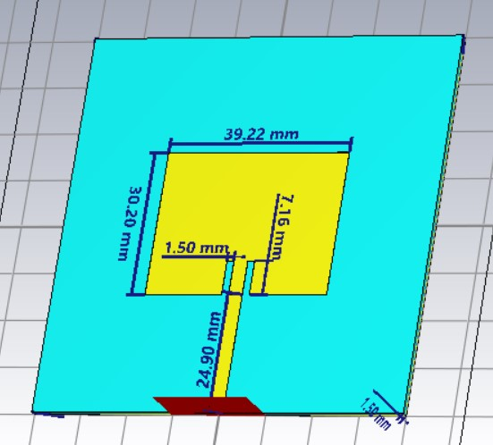
3-D Antenna Diagram

Slide 6
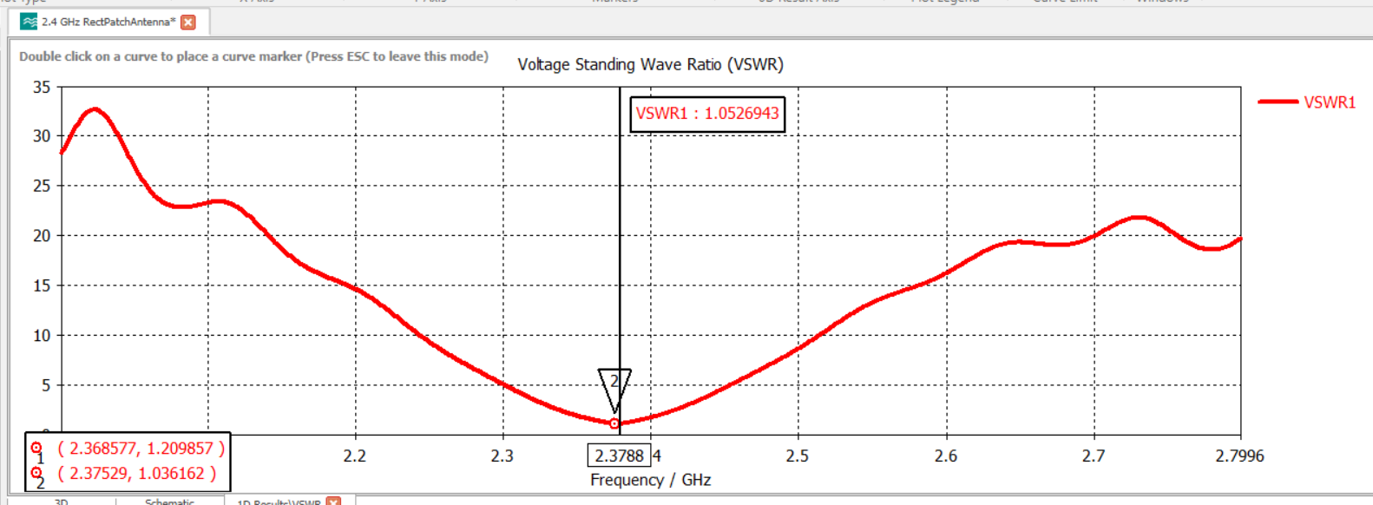
Results
Voltage Standing Wave Ratio = 1.052

Slide 7
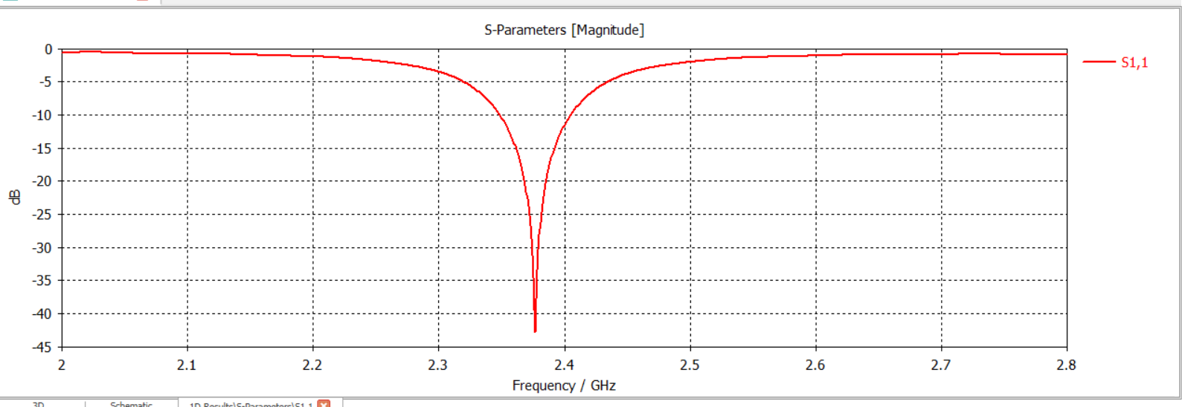
Reflection Coefficient (S₁₁) = -42.57dB Bandwidth at -10dB = 51MHz (2.349GHz to 2.4GHz)

Slide 8
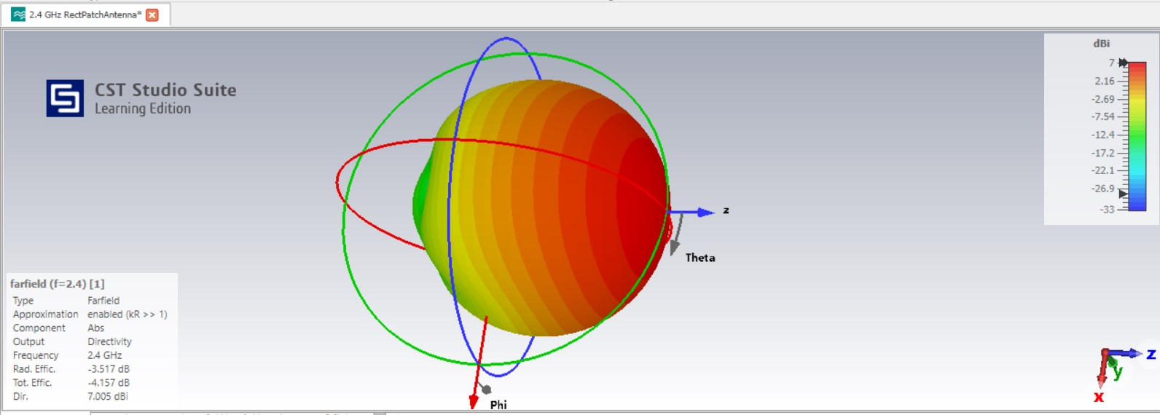
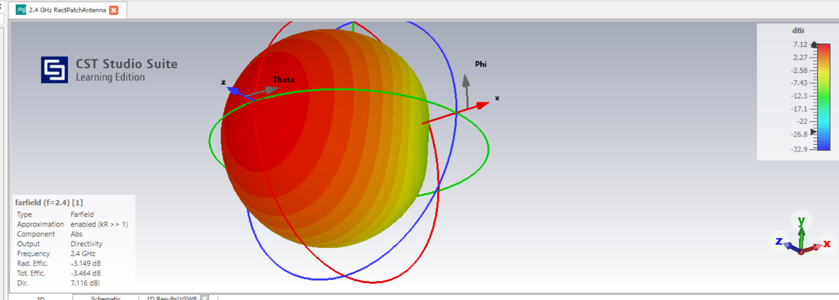
Farfield Radiation Pattern
Gain = 7.0dBi Directivity = 7.005dBi
Total efficiency = -4.157dB Radiation efficiency = -3.517dB

Slide 9
Future Work and Advancements
Broadening Bandwidth Techniques like adding slots or using a thicker substrate can be explored to achieve a wider bandwidth.
Using thicker substrates: A thicker substrate reduces fringing fields and increases bandwidth but must be balanced with efficiency considerations.
Improving Efficiency Substrate materials with lower dielectric losses, such as Rogers RT/duroid having dielectric coefficients of 2.33, can be used to reduce efficiency losses.
The 2.4GHz band is preferred for longer-range communication due to its better penetration through walls, though it is more susceptible to interference than the 5–6GHz band
The 5.2GHz frequency band is less congested than the 2.4GHz band, which is shared with Bluetooth devices, microwave ovens, and other household appliances.

Slide 10
The 5GHz band offers more non-overlapping channels (e.g., 20 MHz or 40 MHz wide), reducing co-channel and adjacent-channel interference.
The shorter wavelength at 5.2GHz enables wider channel bandwidths (e.g., 40 MHz, 80 MHz, or 160 MHz), which can achieve significantly higher data throughput.
Reduced Range: The shorter wavelength of 5.2GHz leads to reduced range and penetration compared to 2.4GHz. It is less effective through walls and other obstacles.
Power Restrictions: Regulatory limits often impose stricter power levels for 5GHz bands, further reducing their range compared to 2.4GHz.

